Slide 1


Slide 2
my personal beliefs about machine learning
Machine learning methods are now solidly into “required toolbox” territory for scientists
There is often a trade-off between interpretability and capacity (the ability to model complex relationships)
Always use the simplest method that works (Occam’s razor, but for methods)
When we apply them to Astrophysics problems, I think our standards for interpretability should be higher than in other contexts
I think “science” requires generating insights that are useful for others
I loved this article: “The fallacy of AI functionality” (suggested to me by Dr. Savannah Thais) as a framework to think about standards for AI frameworks
Bottom line: you will hear about very simple methods from me. I like applying simple methods to simple problems.

Slide 3
Algorithm #1: decision trees

Slide 4
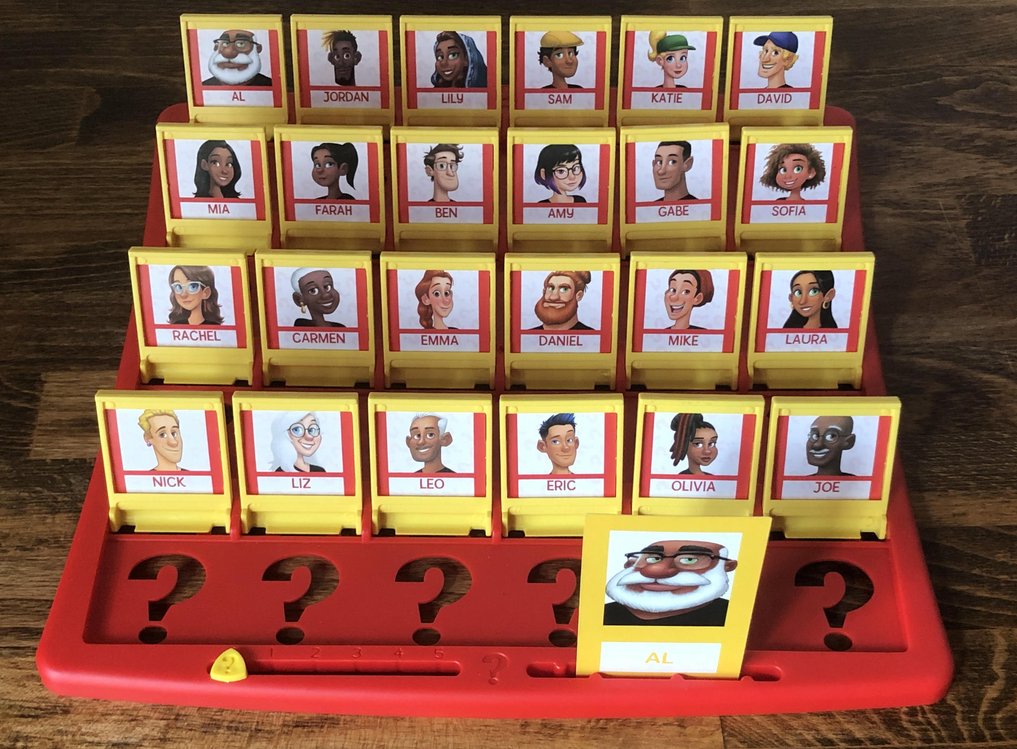
DECISION TREES
Work by splitting data on different values of features
Simplest trees are binary trees
If categorical features, the split would be on yes/no
If numerical, the split would be on a certain value (e.g. x > 100 or x < 100)
Notes:
Let’s figure out the features of the Guess Who problem.

Slide 5
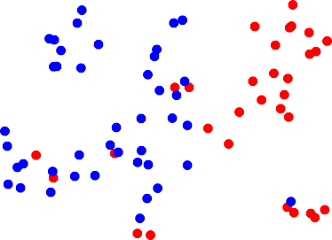
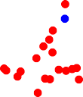
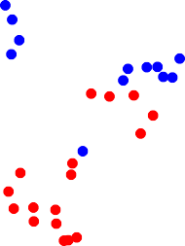

Example: This 2-feature data set.
How should we split?
X₂
Figure credit:
Gilles Louppe
X₁

Slide 6



Example: This 2-feature data set.
How should we split?
X₂
0.5
Figure credit:
Gilles Louppe
X₁

Slide 7
Should we stop?
0.7
X₂
0.5
Figure credit:
Gilles Louppe
X₁

Slide 8




nodes (Splits and leaves) define the decision tree
X₂
𝒙
t₄
Split node
t₅
𝑡₁
𝑋₂ ≤ 0.5 ?
>
<=
Leaf node
𝑡 ₂
≤ >
𝑋₁ ≤ 0.7 ?
𝑡 ₃
0.5
𝑡 ₄
𝑡 ₅
t₃
In a terminal node (leaf),
the model is ready to output a classification
(and all objects in that leaf have the same class)
0.7
X₁
Figure credit:
Gilles Louppe
Important questions:
How do we decide which splits to make, among the many
possible ones?
How do we decide whether we should stop?

Slide 9
Building decision trees
Find measure of impurity (e.g. Gini impurity) that we want to minimize.
Find splits that maximize decrease of impurity
Select stopping criterion as impurity < ε (e.g. , 0)
Gini (node L) = 1 - ∑ f(i)²
where f(i) is the frequency (=fractional abundance) of the i-th class
L_{L}/L * (1 - ∑ f(i)²)_{L} + L_{R}/L * (1 - ∑ f(i)²)_{R}
L = total # of objects in original split; L_{L} and L_{R} = # of objects in each of the new splits

Slide 10
Which split should we do first?
Let’s calculate the Gini impurity in the original and each of the two.
L_{L}/L * (1 - ∑ f(i)²)_{L} + L_{R}/L * (1 - ∑ f(i)²)_{R}

Slide 11
(1 - ∑ f(i)²) =
1 – (6/15)^2 – (9/15)^2
= 0.48
L_{L}/L * (1 - ∑ f(i)²)_{L} + L_{R}/L * (1 - ∑ f(i)²)_{R}
= 4/15 * 0 + 11/15 * (1 – (6/11)^2 – (5/11)^2) = 0.363
L_{L}/L * (1 - ∑ f(i)²)_{L} + L_{R}/L * (1 - ∑ f(i)²)_{R}
= 7/15 * 0 + 8/15 * (1-(2/8)^2 – (6/8)^2) =
0.2

Slide 12
Pseudo code for decision trees
function BuildDecisionTree(L)
Create node t from the learning sample L_{t} = L; calculate (im)purity
if the stopping criterion is met for t then
stopping criterion
Gini (im)purity = 0
y^ = some constant value/class (MAKE PREDICTION)
Gini (node L) =
1 - ∑ f(i)²
where f(i) is the frequency of the i-th class
Gini (splits L_{L} and Lr) =
L_{L}/L * (1 - ∑ f(i)²) +
L_{R}/L * (1 - ∑ f(i)²)
where f(i) is the frequency of the i-th class
Note:
splits
happen
along (single) features!
t
else
Find the split on L_{t} that maximizes impurity decrease
s∗ = arg max ∆i (s, t)
s∈Q
Partition L_{t} into L_{tL} ∪ L_{tR} according to s∗
t_{L} = BuildDecisionTree(L_{L})
t_{R} = BuildDecisionTree(L_{R} )
end if
return t
end function
Code adapted from Gilles Louppe

Slide 13
Our first example will be a supervised classification problem, in which we attempt to predict if a planet is habitable, based on its distance from parent star, mass of parent star, and orbital period.
We are now ready to build our first tree
(with pen and paper!)

Slide 14
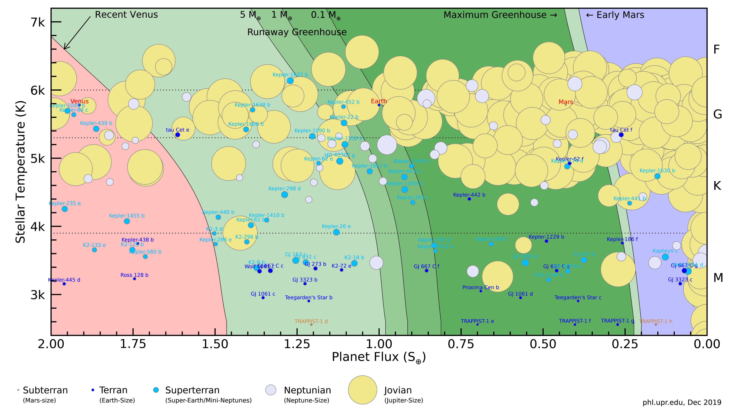
Data from the Planet Habitability Lab at Arecibo Observatory

Slide 15
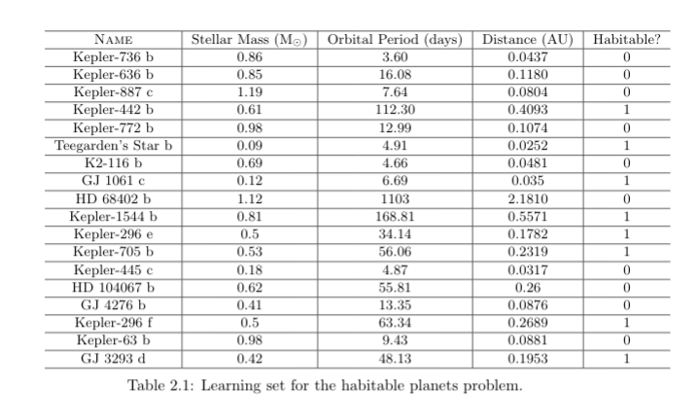

Slide 16
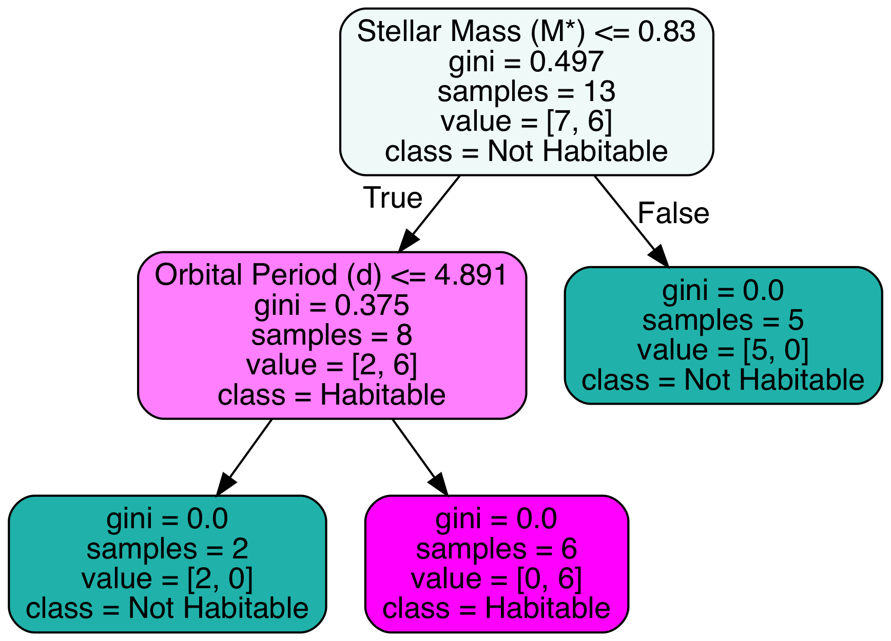
Let’s see what sklearn says
Notes:
Note: how would the Earth fare on this one?

Slide 17
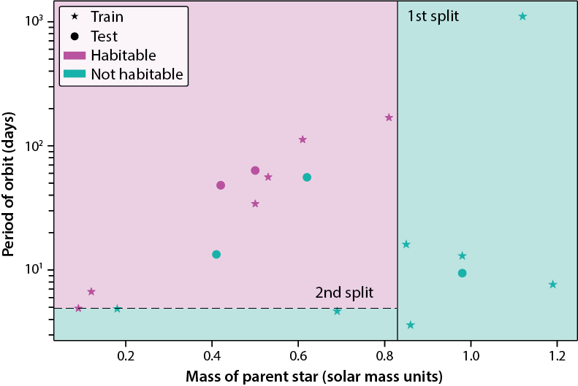
And visualize the criteria that we found!
Can you figure out the accuracy on the test set?

Slide 18
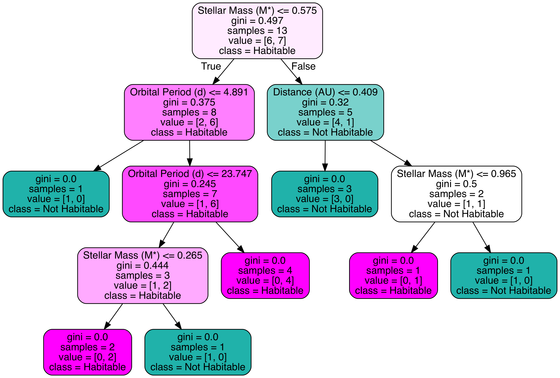
Note (and we’ll see code for it): if you use the last 13 rows for training and the first 5 for testing, you get this tree:
and 100% accuracy on test set
Morale: Different train/test split might give significantly different performances,
especially when data sets are small.

